Slide 1

Web scraping to gain company insights
27/09/2023

Slide 2
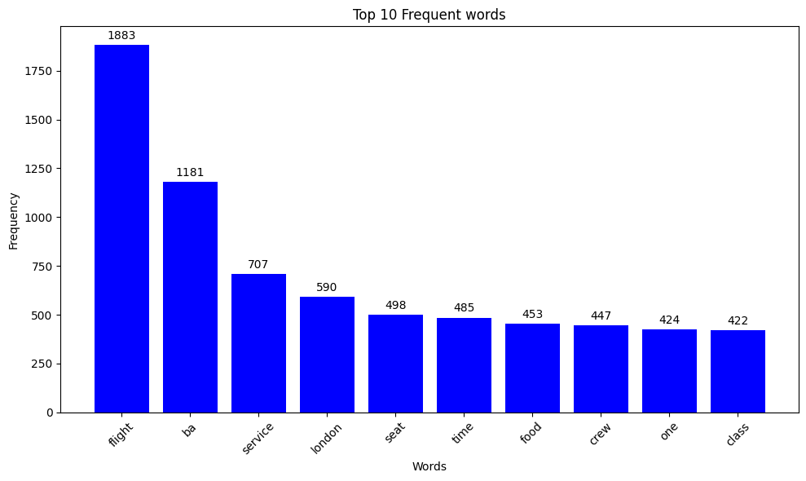
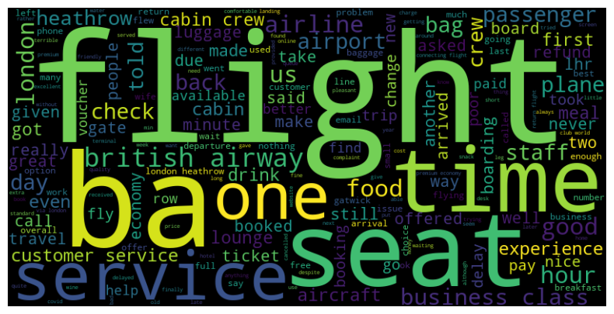
INSIGHTS FROM CUSTOMER REVIEWS
Observed sentiment analysis of 1000 reviews given by the customers,
Positive Reviews - 485
Negative Reviews - 483
Neutral Reviews – 32
Word cloud of keywords used in reviews and frequency plot of top 10 most common words.

